Slide 1
Two-Stage Conditional Sample Error Weighting for Improved CCAO Forecasting Accuracy
By: Douglas Williams

Slide 2
2025 modeling objectives
We seek to improve the forecasting accuracy of the 2025 CCAO evaluation model such that we have reduced error when predicting January 2025 sales prices.
We aim to achieve improved forecasting accuracy without changing the model class, hyperparameter search protocol, or evaluation pipeline.
Gradient-boosted tree models have many benefits that we wish to preserve (e.g. lightweight, explainable, easy to generate counterfactuals).
New steps should be low-lift for the CCAO data team to implement and easily tunable for troubleshooting and future adjustments.
Generate very little in the way of new code and extra steps.

Slide 3
Proposal: Two-stage conditional sample weighting
I propose two stages of sample weighting to adjust for pre-2021 trend model bias:
Weight all samples during training to overcome model’s pre-2021 prediction accuracy bias.
Requires only a few additional lines of code in training script.
Can select best error weighting function using simple cross-validation.
Weight incomplete 2024 sales data so they represent the expected / true sales count and characteristics distribution.
Adjust for sales count by either assuming a similar count to 2023 or by predicting count using regression model.
Adjust for characteristics distribution using IPW weighting, where we estimate P(2023 sale | sale characteristics) with a logit model.

Slide 4
Complexity bias in theory
2024 model’s pre-2021 bias
Proposed solutions
Appendix I: Assumptions about conditional sales distribution
Appendix II: Views of target time-fixed effects

Slide 5
Complexity bias in theory
2024 model’s pre-2021 bias
Proposed solutions
Appendix I: Assumptions about conditional sales distribution
Appendix II: Views of target time-fixed effects

Slide 6
A “perfect” model’s predictions should produce the same variance as the true values
Statistical interpretation of training loss is the maximum likelihood estimation (MLE), which is formulated as such:
Given some observed values {y₁, y₂, y₃, …} which we assume come from a distribution parameterized by some unknown 𝜃.
We have a likelihood function L(y₁, y₂, y₃, … | 𝜃) which returns the likelihood of observing the given values from a distribution parameterized by 𝜃.
The maximum likelihood estimator is a model which produces the distribution from which the observed sample has the highest probability of being drawn.
Assuming a representative training set, upon repeated sampling our ideal model produces a distribution indistinguishable from the true data-generating process.

Slide 7
Input space regions corresponding to high variance targets should demand more attention during training
Decision trees begin optimization with zero prediction variance (first prediction is mean of training data).
“Matching” variance is achieved by learning to split the input space up into different prediction cells.
The cells are the buckets the inputs are sorted into after passing through the decision tree.
More complex decision rules are achieved by splitting regions of the input space with high variance targets into more cells.
Mechanistically, splits along the tree are determined by the input-space separation that creates the largest decrease in loss (purpose of the “gain” function).
Input space regions corresponding to complex or high variance decision rules generate more error, so splitting them allows more variance in output thus reducing error.

Slide 8
In practice, ruthless loss-minimization leads to trade-offs in input space regional decision-rule complexity
Ideally, the model seeks to distribute its decision rule complexity budget (number of cells) across regions of the input space proportional to the variance of targets associated with said regions.
But low-variance regions are inherently easier to learn decision rules for!
Mechanistically, the model may get quick loss reduction when focusing on easy to predict regions of input space compared to complex regions which require more splits before substantial returns.
Intuitively, when the model sees greater early reductions in loss from easy-to-learn regions of the input space compared to more complex ones, it will greedily allocate its complexity budget towards these regions at the cost of accuracy in difficult regions!

Slide 9
Complexity bias in theory
2024 model’s pre-2021 bias
Proposed solutions
Appendix I: Assumptions about conditional sales distribution
Appendix II: Views of target time-fixed effects

Slide 10
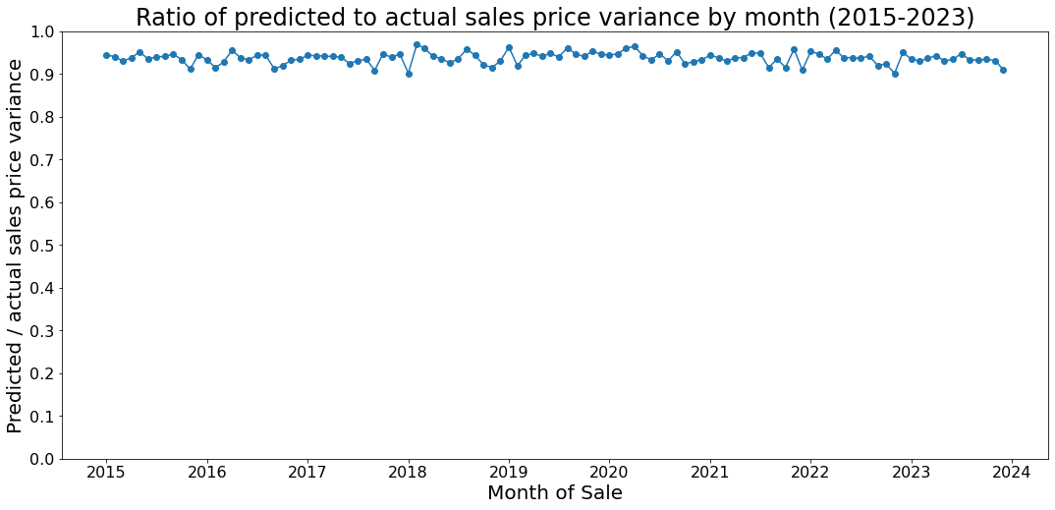
Variance ratios show the 2024 model is allocating complexity to match training distribution (target variance)
Model predicted sales variance by month is consistently ~94% of actual sales price variance

Slide 11
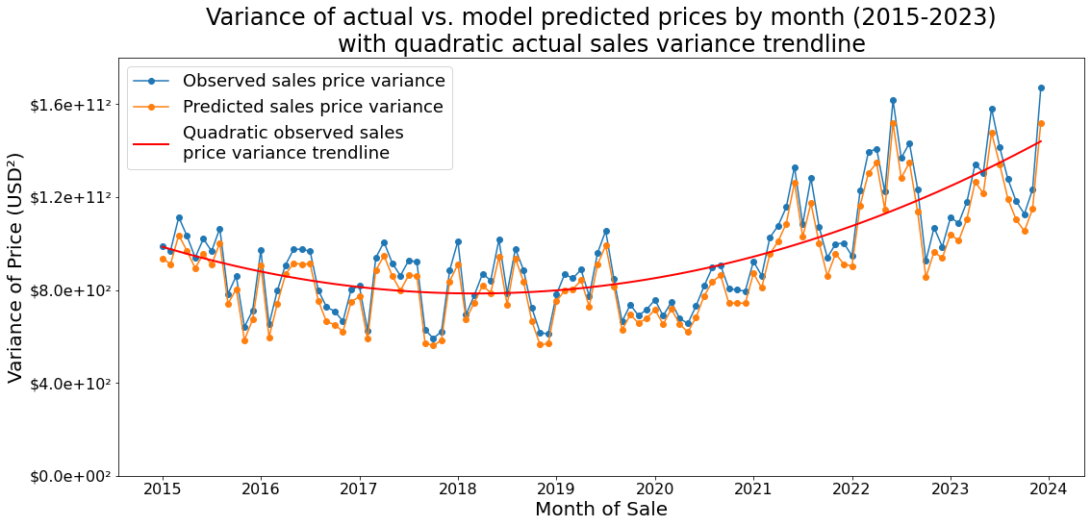
But true sale price variance doubled from 2020 to 2023

Slide 12
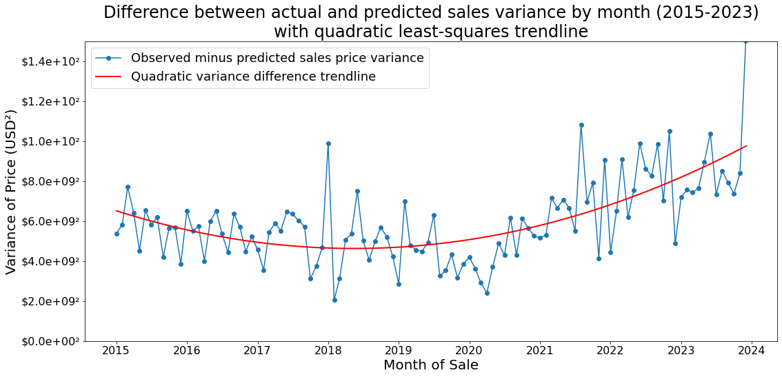
Gap between predicted and observed price variance grows with observed variance
Predicted price variance is still ~94% of observed, but observed variance increases so gap grows

Slide 13
A “balanced” model’s error distribution will match sample frequency distribution with respect to time
If model errors / accuracy are uncorrelated with sample characteristics:
We expect the mean error per-sample to be the same for each month
If model errors are uncorrelated with time but the distribution of other sample characteristics is the consistent across months:
We expect the mean error per-sample to be the same for each month
If (1) or (2): The normalized distributions of sum of squared errors and sample frequency by month should match.
If these distributions do not match: model errors are correlated with regions of input space
Higher sum of squared error compared to sample frequency indicates higher per-sample errors (and/or substantial outlier presence)
Lower sum of squared error compared to sample frequency indicates low per-sample errors
Together, these indicate the regions of input space the model is biased towards

Slide 14
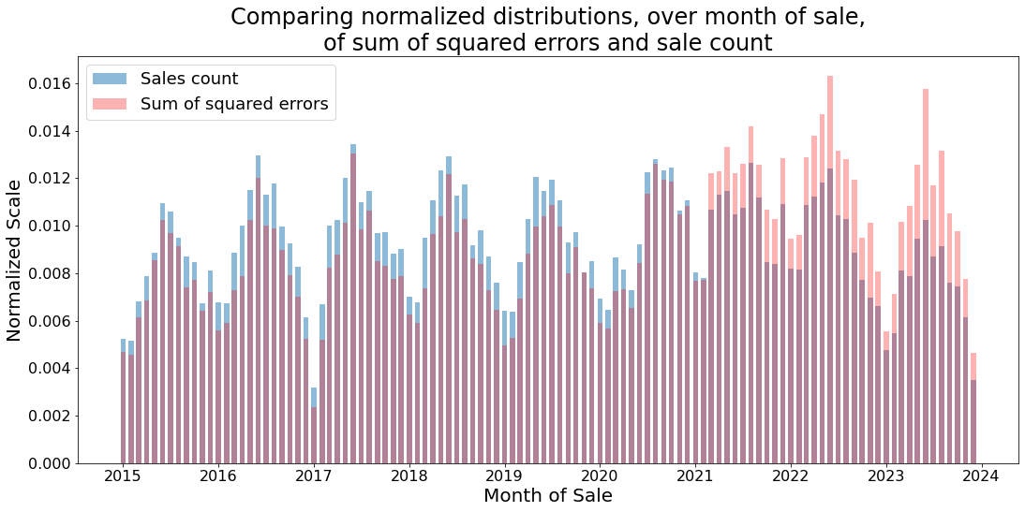
Model performance biased towards pre-2021, easier to learn regions of input space sacrificing post-2021 accuracy
Average error per sample higher post-2020

Slide 15
Our application requires strong rules for post-2020 period
The use case of this model is to predict prices in January of the new year.
January 2025 is post-2020 and thus prices follow the observed higher variance / complexity rules.
The composition of post-2020 sales is more likely to match the composition of January 2025 sales.
The most important rules and correlations for our application exist in the post-2020 data, but the model is biased towards pre-2020 performance.
This does not mean pre-2020 data does not contain valuable correlations for predicting post-2020 values.
The question becomes, how do we characterize and shift the model’s pre-2020 bias?

Slide 16
Complexity bias in theory
2024 model’s pre-2021 bias
Proposed solutions
Appendix I: Assumptions about conditional sales distribution
Appendix II: Views of target time-fixed effects

Slide 17
Weighting the errors of more recent samples shifts model’s attention during training
The model chooses the parameters (splitting decisions) which give it the greatest decrease in the sum of squared errors.
If there are more data points in region A of input space than region B, learning region A’s patterns will accrue larger reductions in error. (Assuming evenly distributed errors)
If it is easier to learn rules for a region of input space, it likely takes fewer rules compared to a more complex region of input space to reduce errors an equivalent amount.
Pre-2020 trends have both more data samples (A) and lower target variance (B) compared to post-2020, so the model’s performance is biased towards this period.
By increasing the errors generated by post-2020 samples, we nudge the model towards prioritizing performance on recent trends and counteract the pre-2020 bias.

Slide 18
In practice, error weighting only introduces two small steps
The naïve decision tree training algorithm, including new weighting steps in red, is as follows:
def weight_func: x → w; maps sample characteristics to scalar weight
While stop_condition == False:
split_errors = [ ]
For split_rule in potential_splits:
temp_tree = current_tree.append(split_rule)
split_errors.append( 𝚺[weight_func(xᵢ) * (targetᵢ - temp_tree.pred(xᵢ)) ] ² )
new_split = potential_splits[ argmin(split_errors) ]
current_tree.append(new_split)
If (depth == max_depth) or (lead_nodes == max_leaf): stop_condition = True
Notes:
This is a simplified form of the decision tree training algorithm which does not take recursivity into account. When extending to recursive split learning the same concept holds.
Can vectorize / index the weighting step by weighting all samples ahead of time and indexing the weight during the error computation

Slide 19
Weighting errors is low-lift for pipeline
Does not alter train / test split because weighting occurs on errors during training process.
Can incorporate weighting function selection as second cross-validation process:
CV 1: Select model hyperparameters
CV 2: Rolling-origin CV but focusing test sets on post-2020 data to select best weighting function
Train on all data with selected hyperparameters and weighting function
Weighting functions (see next slide) are algebraic and only require, at maximum, a few lines of code.
Weighting of errors is one function call in algorithm when a node’s error reduction is being computed. (see prior slide)
Notes:
I could optionally design some bayesian or optimization scheme to select weight function parameters but we can also just spend a day running a bunch of training loops to see which performs best on post-2020 test set

Slide 20
Potential weighting functions
Goal: Given a month of sale, return a weight such that post-2020 sales are weighted more than pre-2020.
Gaussian Kernel: A gaussian curve with a high standard deviation
Allows us to pick which year / period to be the most weighted (ex. 2023 when predicting 2025).
Can add a linear term to introduce asymmetry so weights after the peak period are higher than before.
Cosine Growth: Similar to gaussian curve but parameterization allows for more intuitive control of behavior
Logistic Curve: A logistic curve centered before 2020 to ramp weights up
Monotonically increases, unlike gaussian kernel, but can add code to adjust this behavior.
Can adjust how steep weight ramp up is.
Custom function: hand-decide which periods should receive more weight and code a function according to these specifications
Any kernel function or positive increasing function

Slide 21
Addressing non-representative recent year sales with propensity weighting
A data issue faced every year is that not all current year sales are available yet.
Most recent trends are underweighted by model because fewer observations exist to generate errors.
Most recent samples may bias model because data is not representative of most recent year’s sales.
We can adjust for these biases using the another error weighting scheme:
Apply a weight to 2024 sales which upwardly adjusts errors such that the model treats the 2024 data as if it has the true total sales count.
Apply a weight to 2024 sales which adjusts errors such that the model treats the 2024 sales data as if it has the true sales characteristics distribution.

Slide 22
Adjusting 2024 samples for representative sales count
Our goal is to apply a weight to the errors of the most recent sales so that, in the eyes of the model, the total number of sales is what it would be if we had all data.
Assuming the total number of sales in 2024 is about the same as in 2023, can either:
Can upweight all 2024 sales flatly: number of 2023 sales / number of 2024 sales.
Can upweight all 2024 sales by month: number of [month] 2023 sales / number of [month] 2024 sales.
Assuming a stable trend in number of sales over time, can either:
Fit a linear regression model on 2015-2023 sale counts to predict total number of sales in 2024.
Then weight by number of 2023 sales / number of 2024 sales.
Fit a linear regression model on 2015-2023 sale counts by month to predict total number of sales by month in 2024.
Then weight by number of [month] 2023 sales / number of [month] 2024 sales.
Notes:
Blue sale count histogram on slide 14 shows very stable count trend (ignoring incomplete 2023 data)

Slide 23
Adjusting 2024 samples for representative characteristics
Assuming the sales characteristics distribution for 2024 is similar to 2023, we want to weight the incomplete 2024 sales so that they have the same characteristics distribution as 2023 in the eyes of the model. (This is IPW weighting)
Want 2024 errors weighted by: 1 / P(2024 sample | sale characteristics)
Sample types overrepresented in 2024 relative to 2023 will be down weighted and vice-versa.
With a good estimate of P(2024 sample | sale characteristics), the weighting will be precise enough that the weighted 2024 characteristics distribution will match the 2023 distribution.
Estimate P(2024 sample | sales characteristics) with a logit (or probit) regression model:
Training data: 2023 and 2024 sales
Dependent variable: Binary indicating whether the sale is from 2024 or not
Independent variables: Sales characteristics set as either numerical or binary variables
Notes:
This step need only apply if we are worried about the representativeness of 2024 sales characteristics. If not no need.
To prepare the training data, we would break out categorical variables into binaries
There is a function that will do this for a column so just loop over categorical columns and apply it

Slide 24
Summary
I propose two stages of sample weighting to adjust for pre-2020 trend model bias:
Use a function to weight all sample errors during training such that post-2020 sales produce higher errors.
Requires only a few additional lines of code in training script.
Can select best error weighting function using simple cross-validation.
Adjust incomplete 2024 samples so they represent the expected sales count and characteristics distribution.
Adjust for sales count by either assuming a similar count to 2023 or by predicting count using regression model.
Adjust for characteristics distribution using IPW weighting, where we estimate P(2023 sale | sale characteristics) with a logit model.

Slide 25
Complexity bias in theory
2024 model’s pre-2021 bias
Proposed solutions
Appendix I: Assumptions about conditional sales distribution
Appendix II: Views of target time-fixed effects

Slide 26
Limitations on patterns model can learn
Decision trees can only add cells to regions of output space which can be differentiated between with classification rules in corresponding input space
If if there are two different clusters in output space which are mapped from indistinguishable (or entirely overlapping) regions of input space, model cannot learn a rule to map to these two different clusters
We assume the increased post-2021 sales variance and prices are due to shifts in the housing market patterns that we can observe in our sales data
But if we cannot observe the property characteristics driving these new patterns, then model cannot learn input space classification rules to predict new sales patterns

Slide 27
Testing learnability assumptions
One way to test if our input space (training data) supports the learning of new patterns is through comparing the variance of conditional sales distributions
If the distribution of sales mapped from a region of input space has low variance, predicting the mean of the mapped region of output space would have low mean error
If the distribution has high variance, predicting the mean of the mapped output space region would have high mean error
If this conditional sales distribution variance increases notably between pre- and post-2021 periods, this means our mean decision tree prediction accuracy will decrease and that either:
There is a pattern but we do not have the necessary variables to separate our input space (data collection problem)
And / or the conditional distribution variance is increasing but there is not a connection to any observable variables (problem space limitation)

Slide 28
Defining conditional distribution variances
Our training dataset X lives in a d-dimensional space where d is the number of residential property characteristic variables
Sales are defined as “y”
We define a “type” to be a (near) unique combination of values of characteristic variables such that properties of the same type occupy approximately the same region of input space
We use a histogram of sales values for a type to approximate P(y | x in type)
We then generate these conditional sales distributions for pre- and post-2021 periods (for example, 2019-2023) and observe the trend in Var(y | x in type)
Doing this across all types we can see if the observed aggregate sales variance increase is due to:
The mean price of different types getting further away (good because we can map these clusters by type) or
The prices of nearly all types vary more (bad because for any region of input space a mean prediction will have increased error relative to pre-2021 period

Slide 29
Complexity bias in theory
2024 model’s pre-2021 bias
Proposed solutions
Appendix I: Assumptions about conditional sales distribution
Appendix II: Views of target time-fixed effects

Slide 30
Defining time-fixed effects
There are two components to the time-fixed effects being learned by the CCAO model:
Seasonal Effects — The effect the month / quarter of the sale has on price, regardless of the sale year.
Appears as a recurring within-year pattern.
Ex. “Homes sell for more in the summer than in the winter.”
Longitudinal Effects — The effect the year of the sale has on price, regardless of the season of the sale.
Captured by the year-over-year trend in prices.
Ex. “Homes are more expensive in in 2023 than they were in 2017”

Slide 31
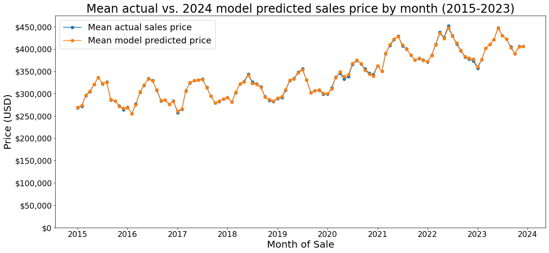
Sales price rises steadily to peak in June before returning to winter low in December / January
Price peaks at about June of each year
Price bottoms out Jan / Dec of each year

Slide 32
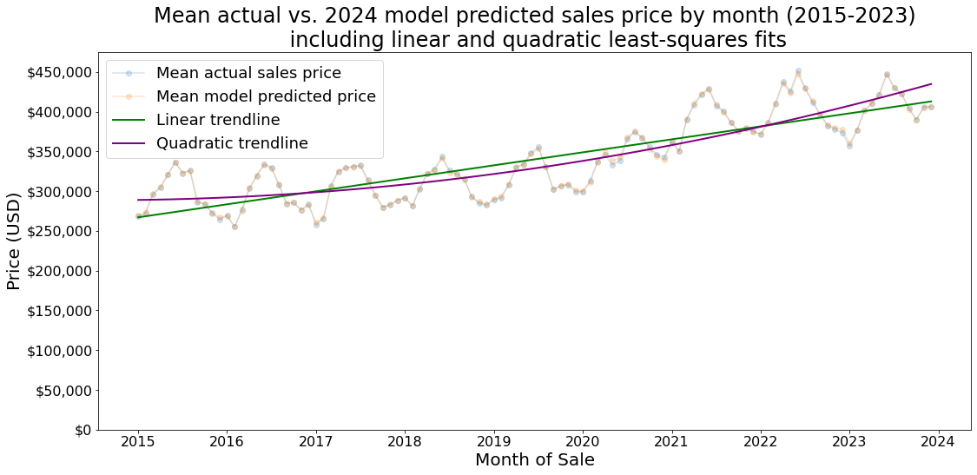
Better fit quadratic trendline suggests price growth accelerating between 2015-2023
Price acceleration inflection point around 2020

Slide 33
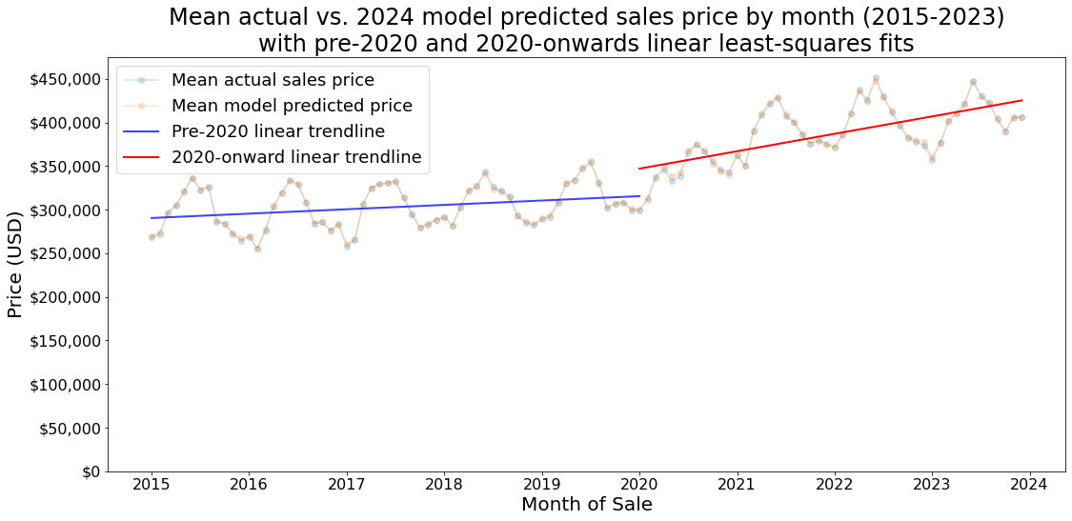
Separate linear trendlines for pre-2020 and 2020-onwards show discontinuous price trend accelerating after 2020

